Slide 1


Twitter Semantic Analysis

Slide 2


Group Members
AMRUTA BORDE
MRUNALI DHASKE
RAZIA PATEL
SHUBHASHIS PRADHAN
YUVRAJ MANDLIK

Slide 3
Table of contents
1
Business Objective
2
Data Set Details
3
EDA
4
Model Building
5
Deployment

Slide 4








4
1
Business Objective

Slide 5










5
Business Objective
Perform Sentiment Analysis of the tweets while gauging their impact and type the architectural level analysis.
Data Transformation and Text Processing using Python or R.
Perform Emotion Mining with adequate Data Visualization.
Deploy using R Shiny, Flask or Streamlit.

Slide 6
6
2
Data Set Details

Slide 7
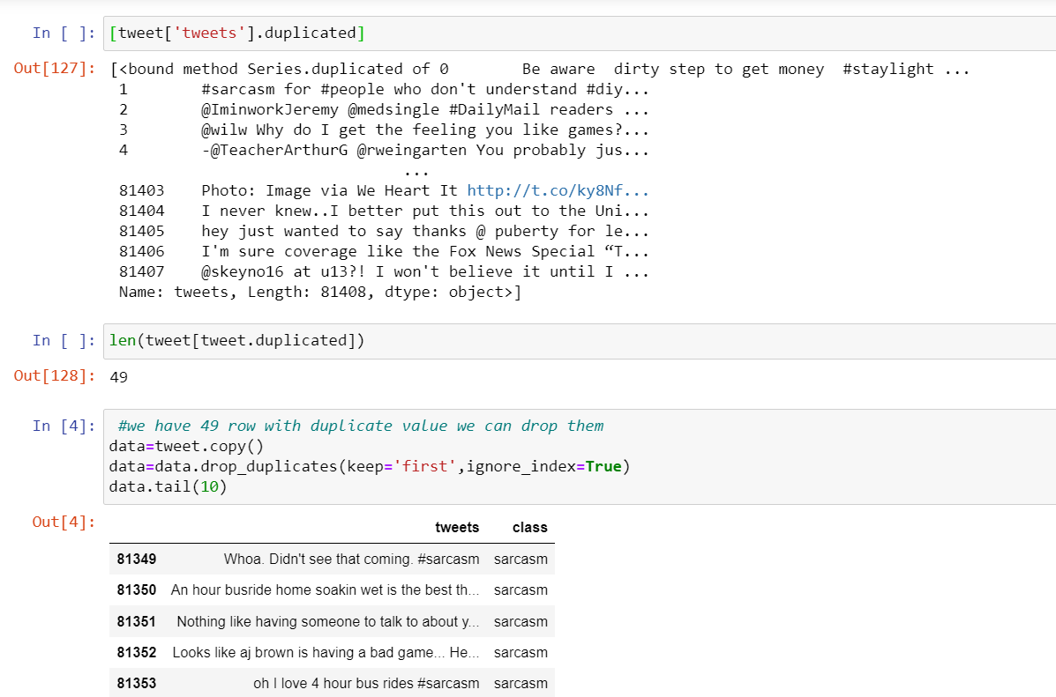
Dataset Overview
7
1. DataFrame Details
- Shape: 81,408 rows x 2 columns
- Memory Usage: 1.2+ MB
2. Column Information
- Column 1: "tweets"
- Data Type: Text (object)
- Non-Null Entries: 81,408
- Column 2: "class"
- Data Type: Text (object)
- Non-Null Entries: 81,408
3. Data Information
- snippet of the data is displayed:
- "tweets" column contains tweet text.
- "class" column contains tweet categories, e.g., "figurative."
4. Data Completeness
- No missing values in either column.

Slide 8
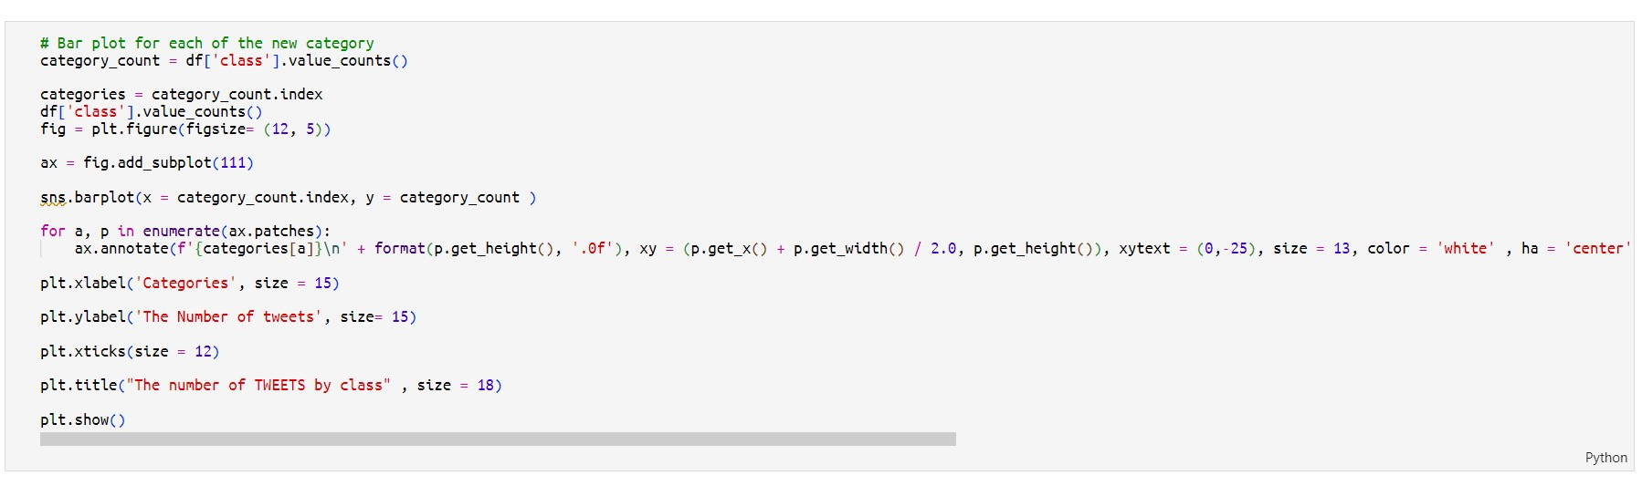
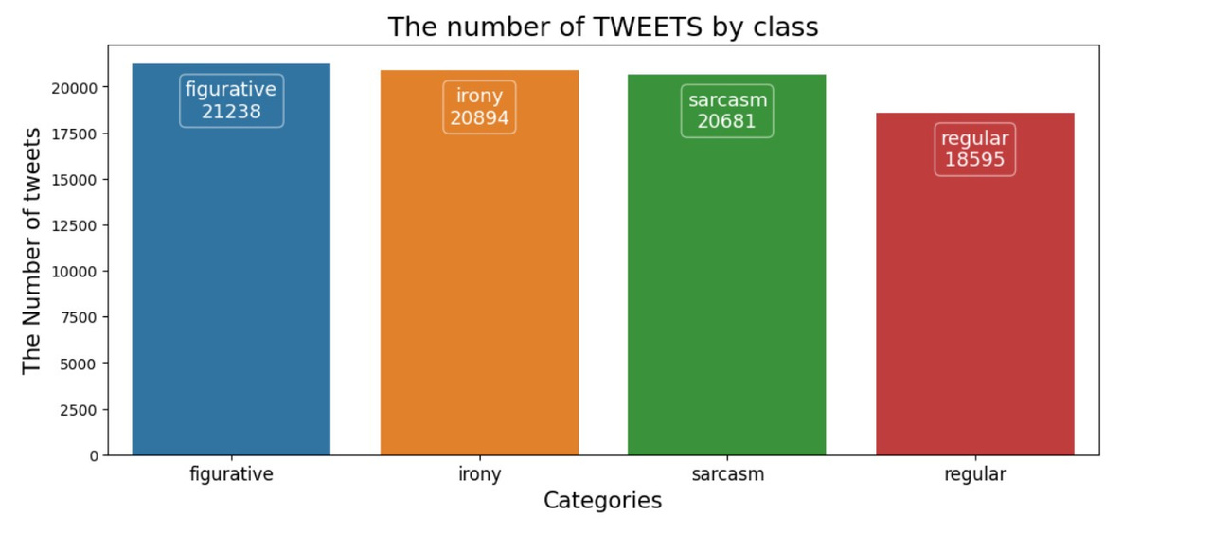
8
We can see that the dataset is well balanced with respect to the given classes

Slide 9
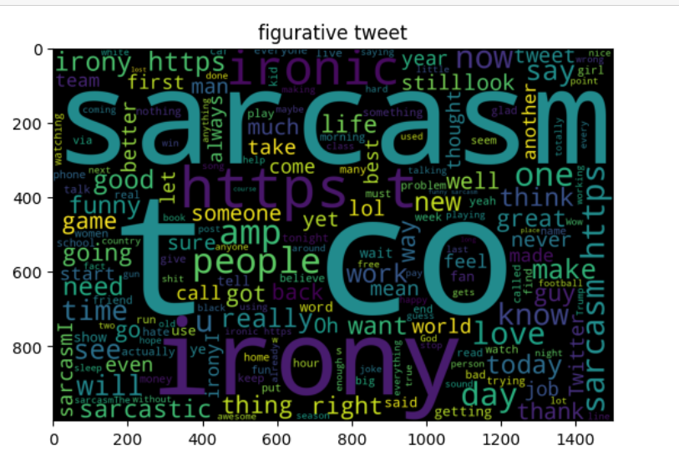
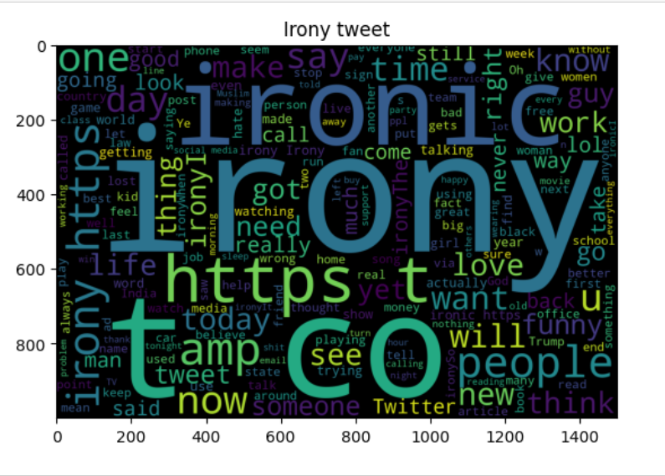
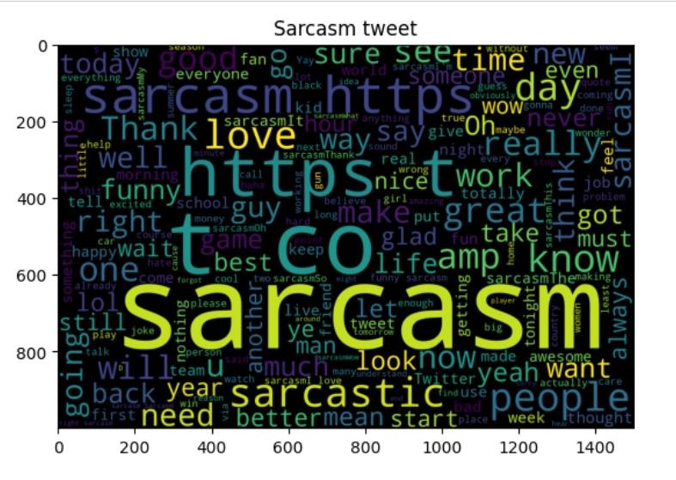
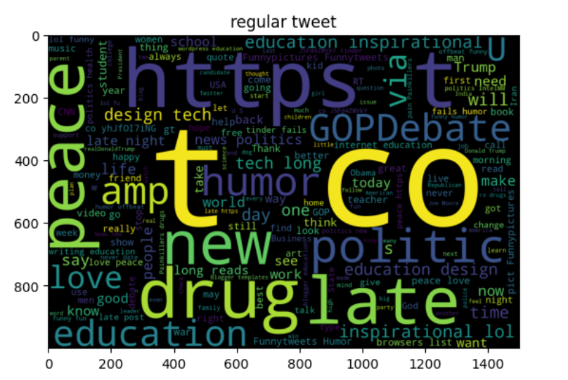
9

Slide 10
10
Text Pre-Processing
1. Lowercasing
2. Punctuation removal
3. Stop words removal
4. Text standardization - replace slang words with formal text,example b4 → before, chk → check abbreviations etc
5. Spelling correction
6. Tokenization
7. Stemming/Lemmatization ( will be using lemmatization)
8. Exploratory data analysis
9. Explore Semantic relationships

Slide 11
12
3
Exploratory Data Analysis (EDA)

Slide 12
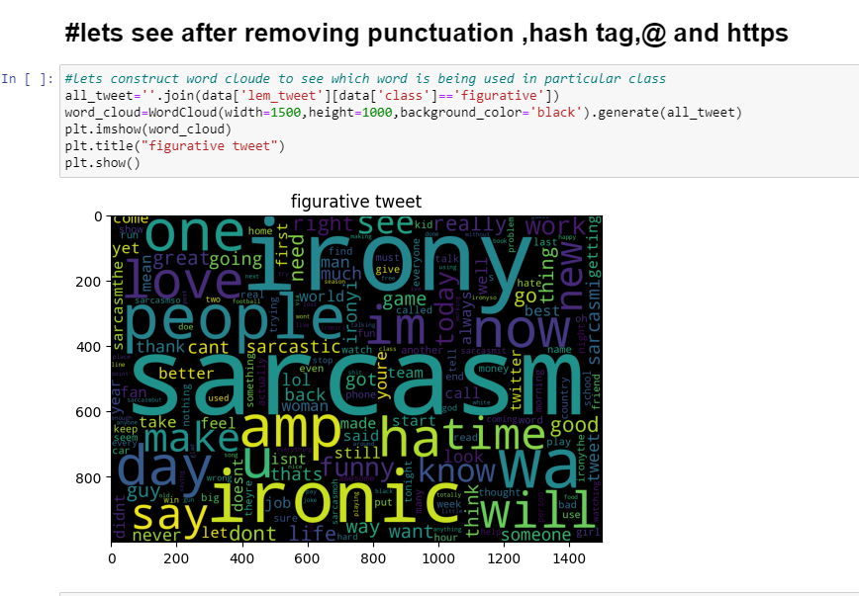
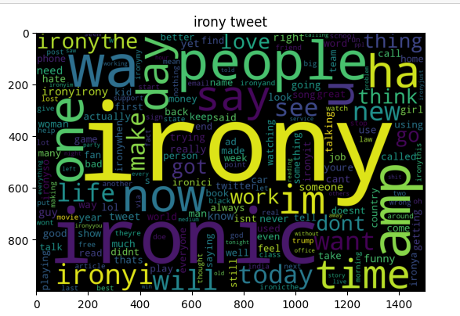
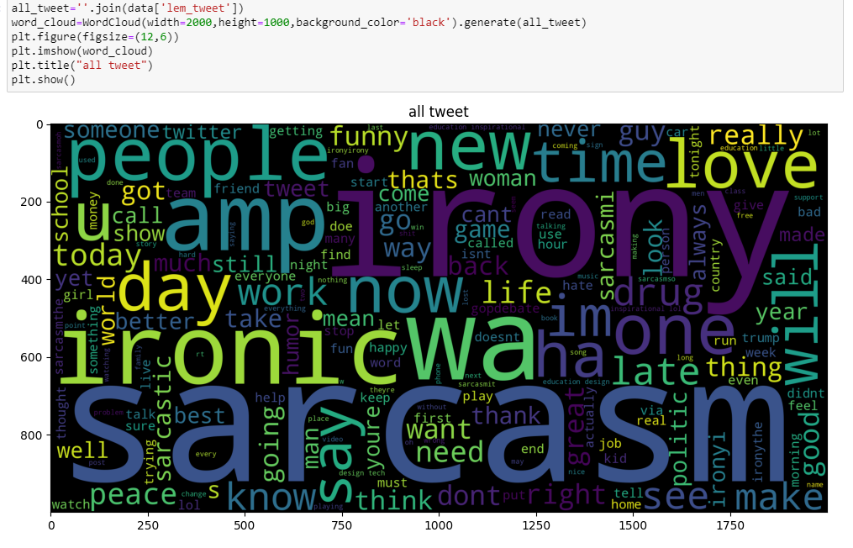
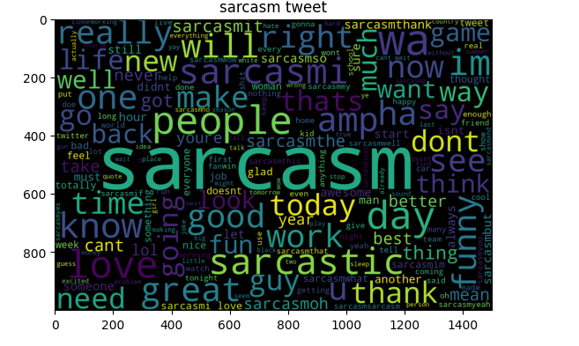
11

Slide 13
15
4
Model Building

Slide 14
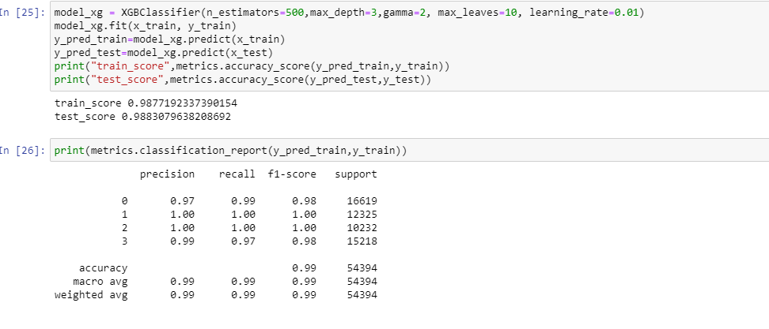

Slide 15
19
6
Model Deployment

Slide 16
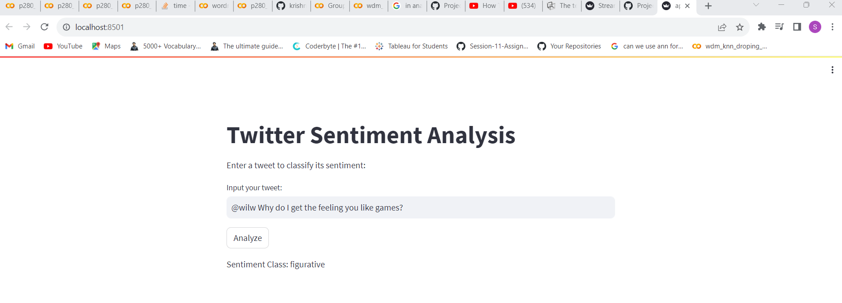
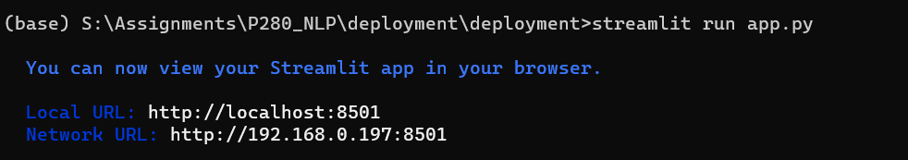
Local deployment

Slide 17
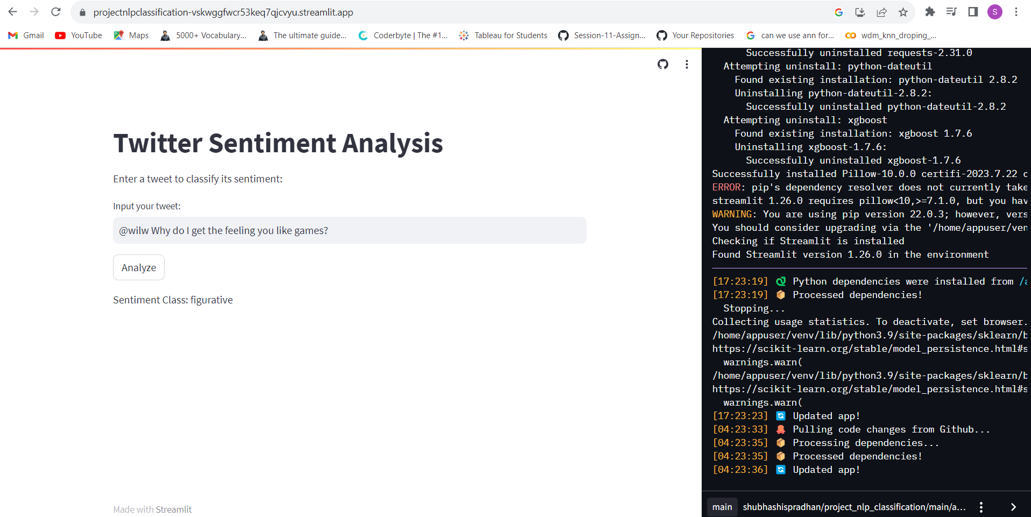
Global deployment

Slide 18
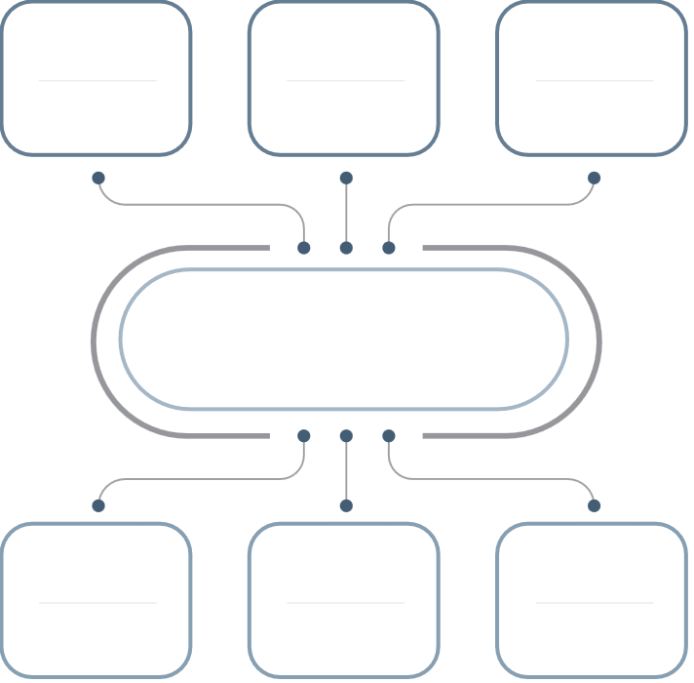













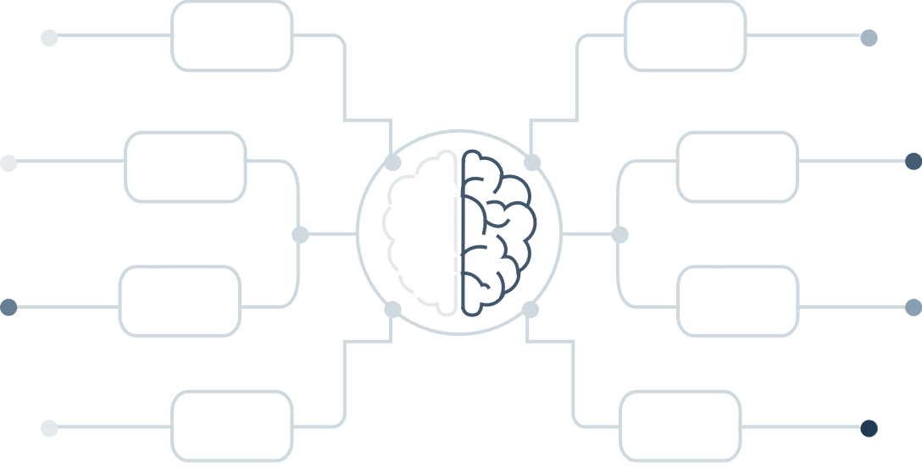
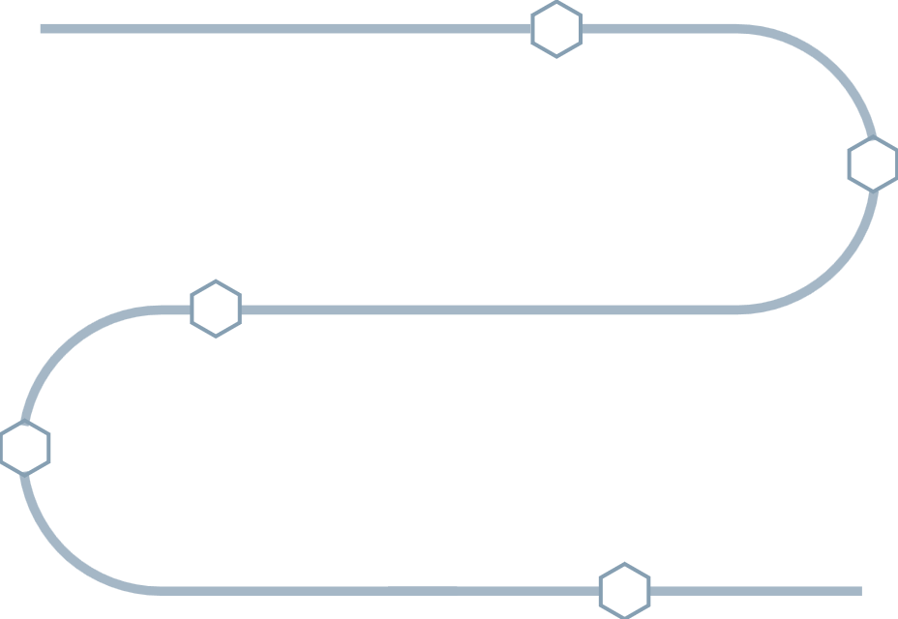



THANK YOU

